Slide 1
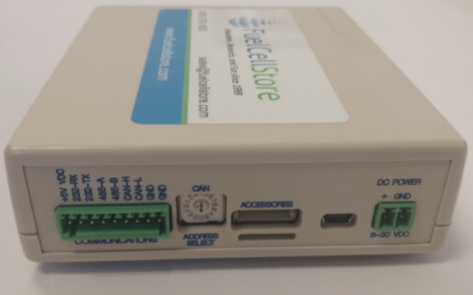
Fuel Cell Monitor
Nolan Kao
Mingoo Jung
John Henderson

Slide 2
Project Overview
The Fuel Cell Monitor (FCM) will be able to monitor up to sixteen cell voltages simultaneously and display them on a web interface and a mobile application.

Slide 3
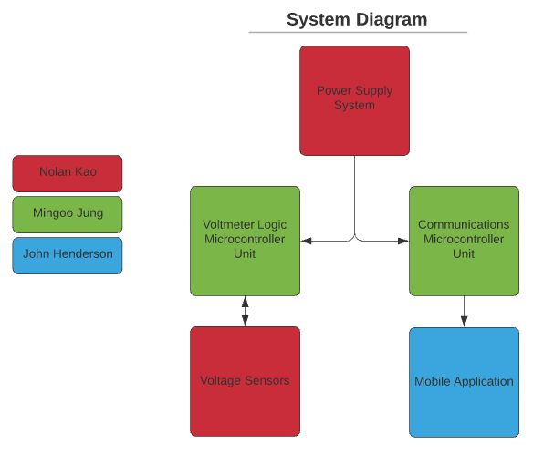
FCM System Diagram

Slide 4
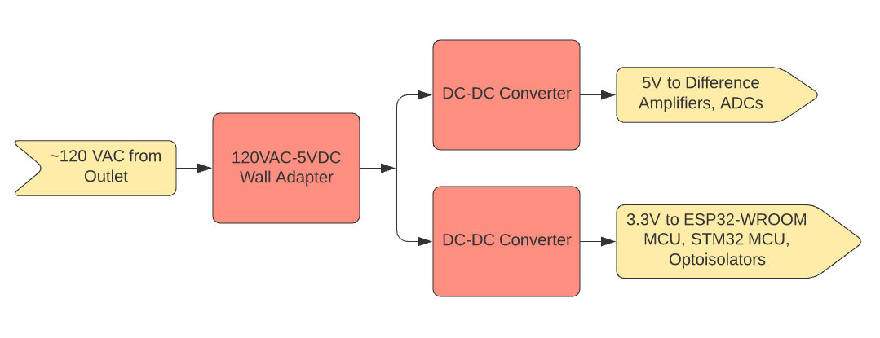
Power Supply Subsystem Diagram

Slide 5
Power Supply Characteristics
120VAC to 5VDC wall plug supplies power to PCB power supply
PCB power supply has two different output source voltages: 3.3V and 5V
3.3V goes to optocouplers, MCUs
5V goes to difference amplifiers, ADCs

Slide 6
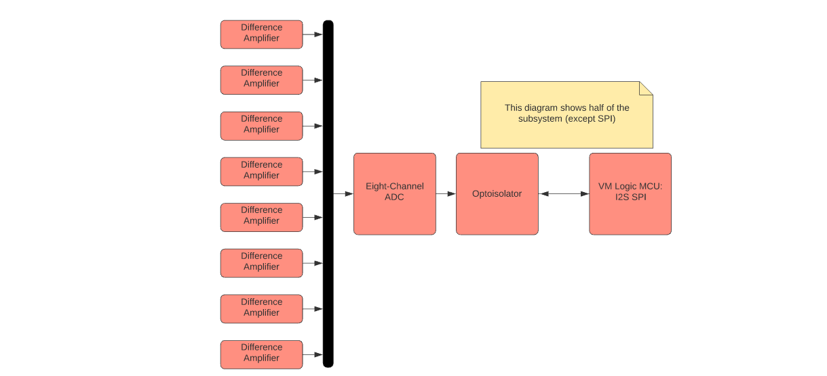
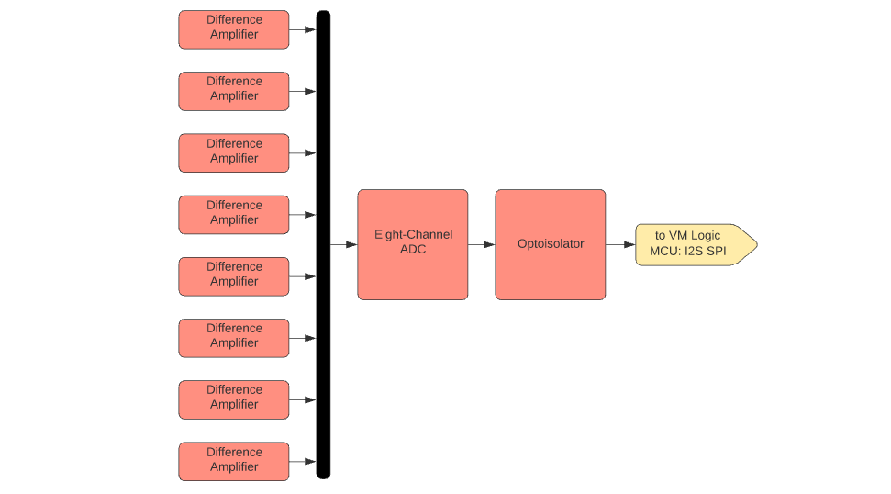
Voltage Sensor Subsystem Diagram

Slide 7
Voltage Sensor Characteristics
Consists of sixteen difference amplifiers, two ADCs, and two optocouplers
Printed on PCB

Slide 8
Update on Power Supply and Voltage Sensors
Nolan Kao
Accomplishments since 403 7 hrs of effort | Ongoing progress/problems and plans until next presentation
Completed redesign of power supply and voltage sensors in Altium Combined both redesigns together | Integrate MCUs into combined design Fabricate aggregated PCB

Slide 9
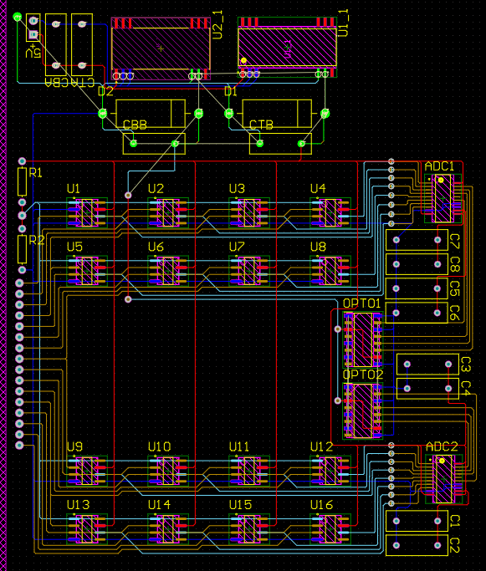
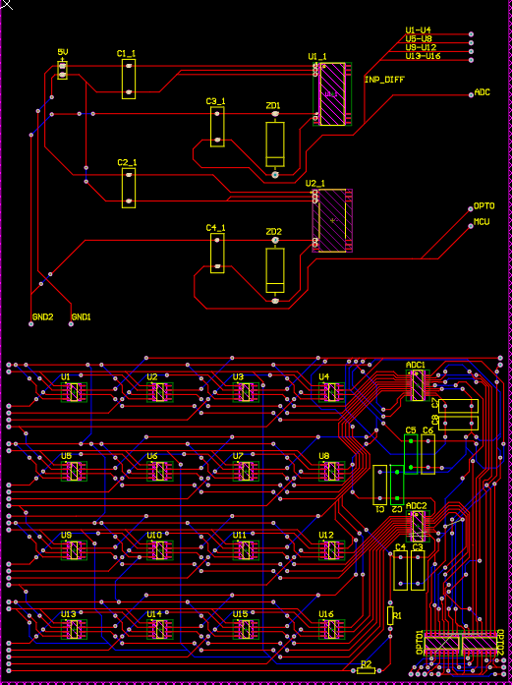
Before After

Slide 10
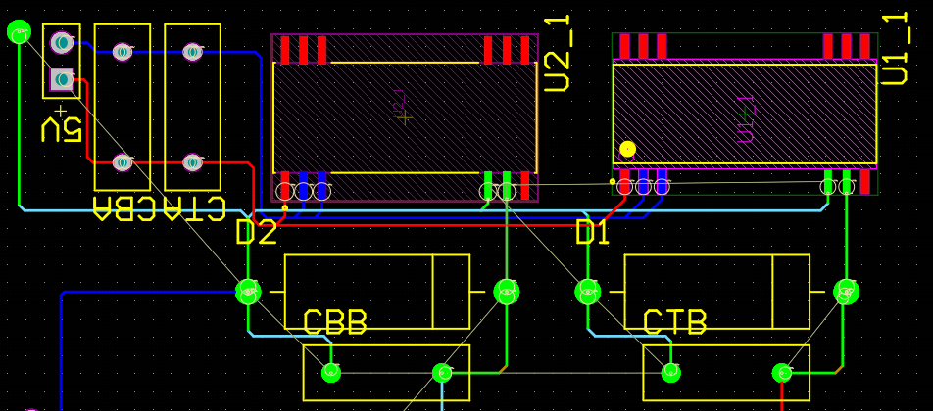
Notes:
Zoomed in image of PS

Slide 11
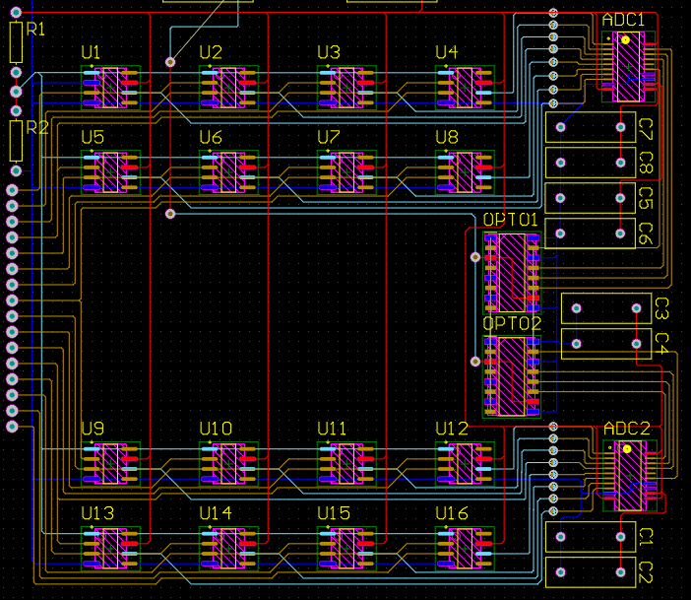
Notes:
Zoomed in image of MSA

Slide 12
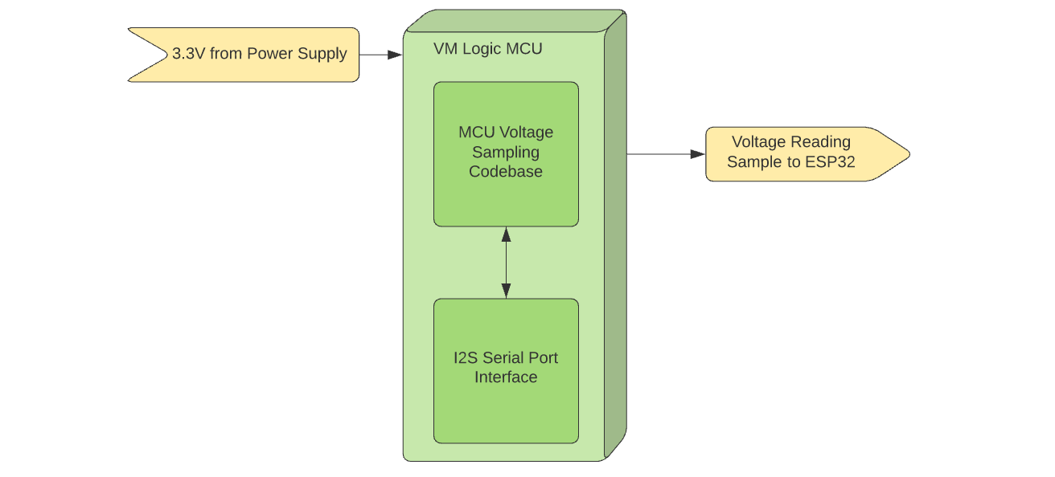
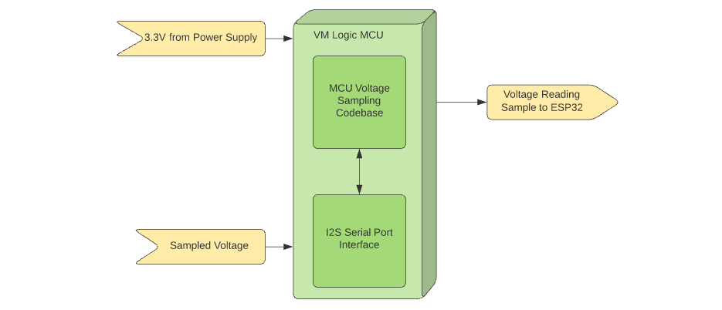
Voltage Logic MCU Subsystem Diagram

Slide 13
Update on MCU Subsystem
Accomplishments since 403 7 hrs of effort | Ongoing progress/problems and plans until next presentation
Combined logic MCU (STM32) and communication MCU (ESP32) Soldering connections on each MCU Validated well functioning of MCU subsystem after soldering | Validation for external power supplying of MCU subsystem Integrate with power supply and ADC subsystem PCB

Slide 14
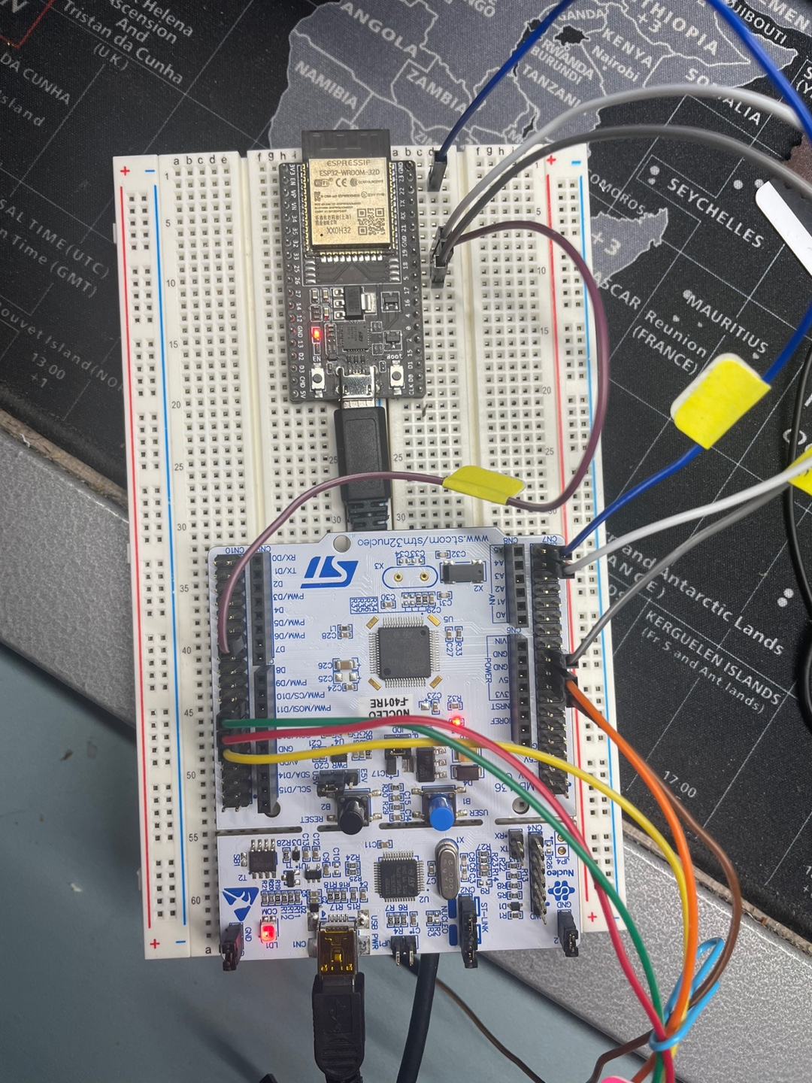
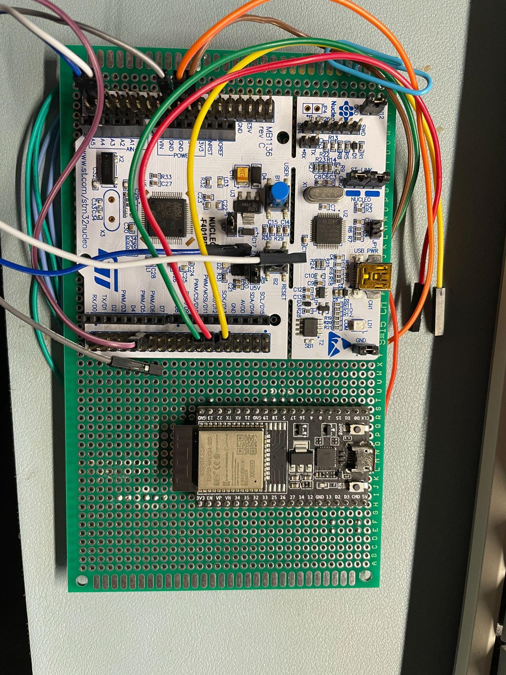
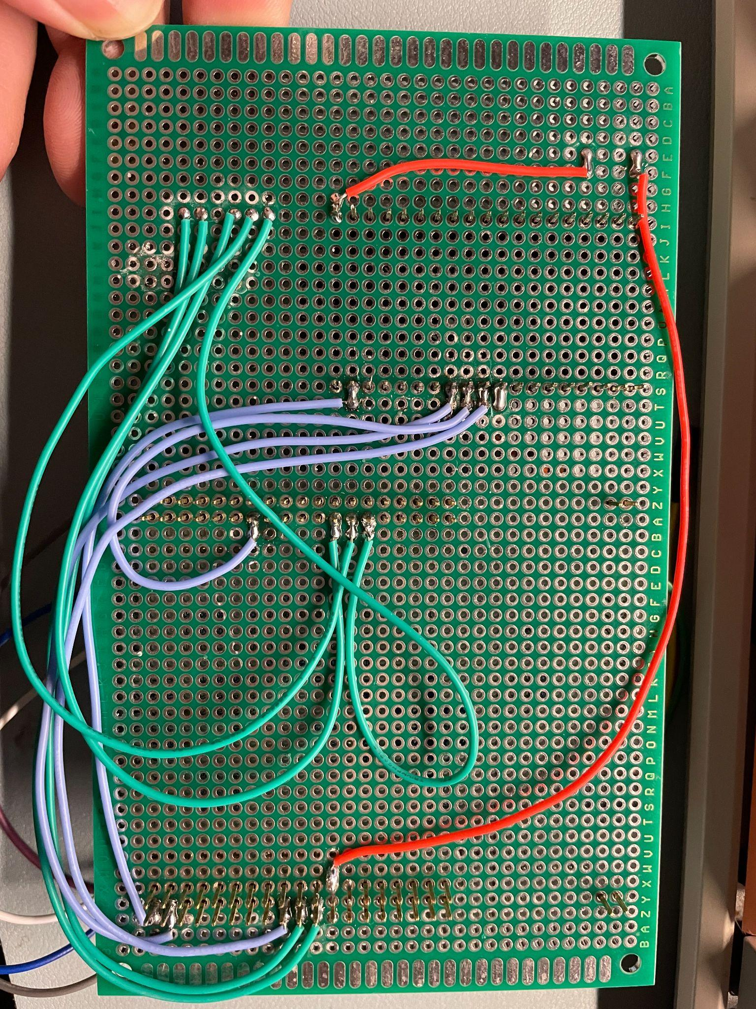
Figure1. Actual Wiring between MCUs from 403
Figure2-1. Actual Wiring between MCUs with soldering
Figure2-2. Actual Wiring between MCUs with soldering

Slide 15
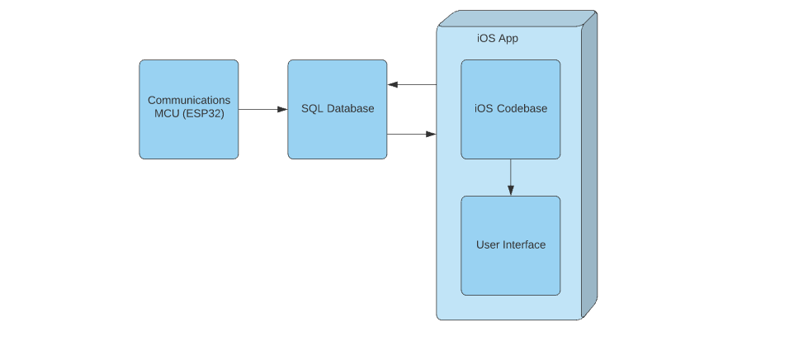
SQL Database and Mobile App Subsystem Diagram

Slide 16
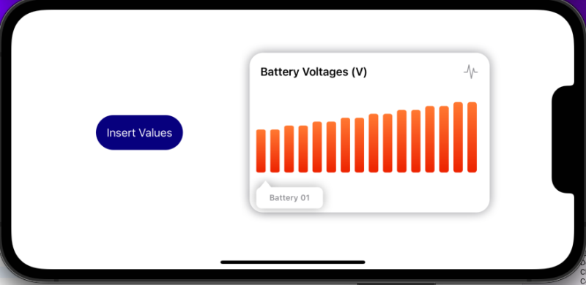
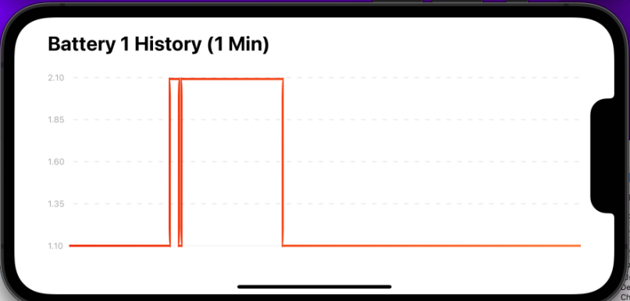
SQL Database and Mobile App Status
Tasks done:
Current values shown in Bar Graph
Last 12000 values stored in line graph
Added button to add 1000 values into database
All values can be verified in xcode terminal
Task in progress
Bluetooth moved to 404
Swiping between graphs during break

Slide 17
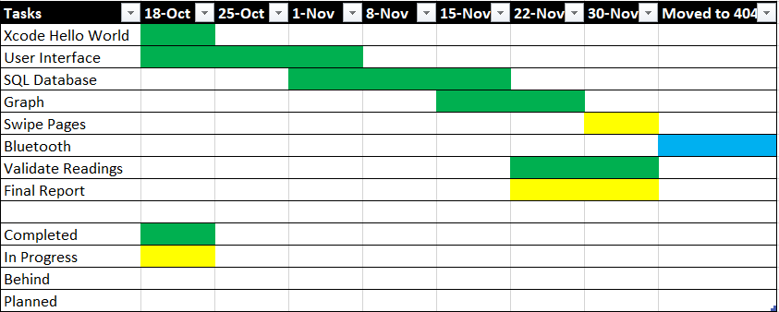
Mobile App Validation Status

Slide 18
Parts Ordering Status
Small components (resistors, capacitors) are placed.
Ordered but not received (independently):
1kΩ resistor (2)
2200 nF capacitor (6)
1000 nF capacitor (4)
100 nF capacitor (2)
Expected receiving date: 01/29/2022

